Slide 1
Blockchain Based Voting System
Members : 1) Gosavi Pratik Sunil 2) Zodge Prakash Rajesh 3) Kalaskar Narayan Purushottam
Guided by : Prof. Gauher Z.

Slide 2
Contents
Introduction
Problem Statement
Aim
Objective
Methodology
Literature Survey
UML Diagrams (Usecase, class)
Proposed work
Conclusion

Slide 3
Introduction
What is Blockchain?
Blockchain is a system of recording information in a way that makes it difficult or impossible to change, hack, or cheat the system.
Consist of several blocks associated with each other and in sequence.

Slide 4
Continued…
Why Blockchain based voting system?
Future election
Fair voting
Secure

Slide 5
Problem Statement
By adopting blockchain in the distribution of databases on e-voting systems can reduce one of the cheating sources of database manipulation.
Blockchain technology is one of solutions, because it embraces a distributed system and the entire database are owned by many users.
Blockchain itself has been used in the Bitcoin, Ethereum, Ripple, Litecoin.

Slide 6
Aim
Aims to building an voting system that satisfies the legal requirements of legislators has been a challenge for a long time.
Distributed ledger technologies is an exciting technology world.
Also aims to evaluate the application of blockchain as service to implement distributed electronic voting systems.

Slide 7
Objective
The election system must be openly verifiable and transparent.
The election system must ensure that the vote cast by the voter has been recorded.
Only eligible voters must be allowed to vote.
The election system should be tamper-proof.

Slide 8
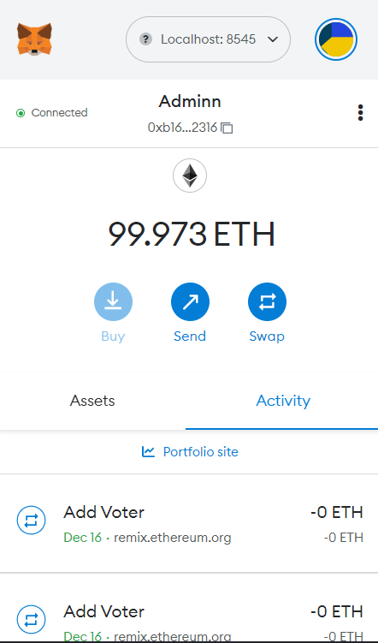
MetaMask
MetaMask is a cryptocurrency wallet that enables users to store Ether and other ERC-20 tokens.
The wallet can also be used to interact with decentralized applications or dapps.

Slide 9
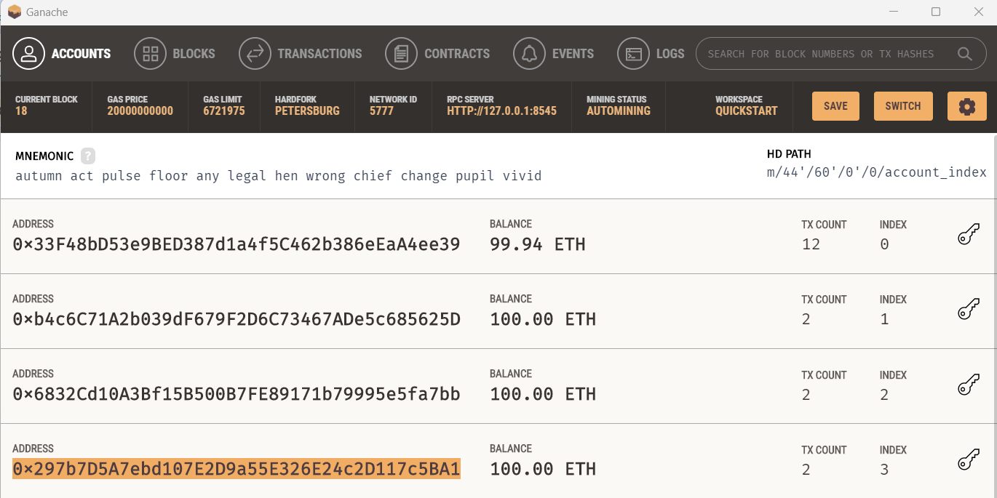
Ganache
Ganache is a private ethereum blockchain environment that allows to you emulate ethereum blockchain so that you can interact with smart contract in your own private blockchain.
Ganache is a personal blockchain for rapid ethereum and corda distributed application development.

Slide 10
Methodology
Open Block Chain
Record transactions in a permanent way.
Closed Block Chain
A private network that maintains a shared record of transactions.
Those who have permission only they can access network.
Cryptography
Symmetric Cryptography
Asymmetric Cryptography
Proof of Work
Start >> Transaction >> Minors >> Block >> Block puzzle >> Proof of Work >> Broadcasted new block to n/w >> Verification of minors

Slide 11
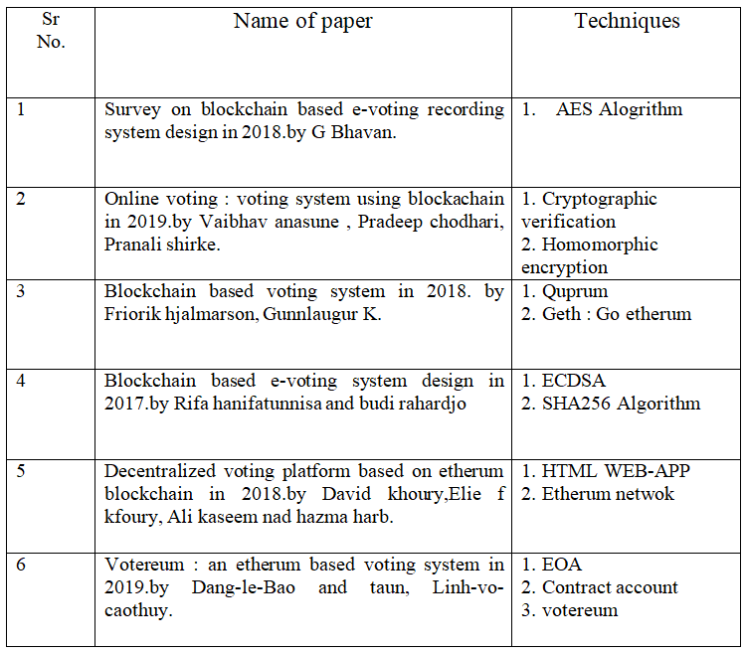
Literature Survey

Slide 12
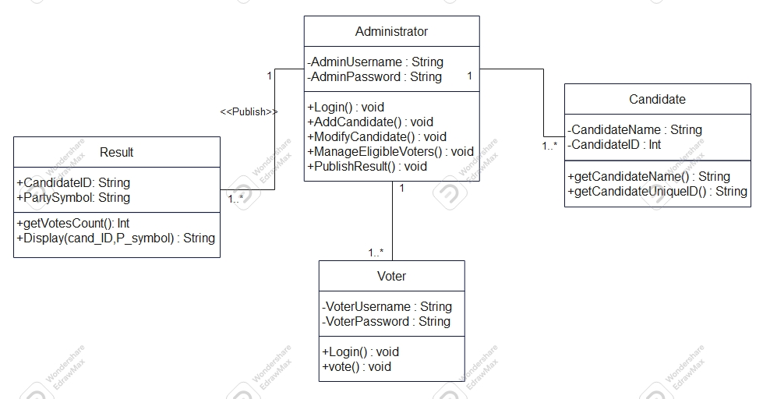
Class Diagram

Slide 13
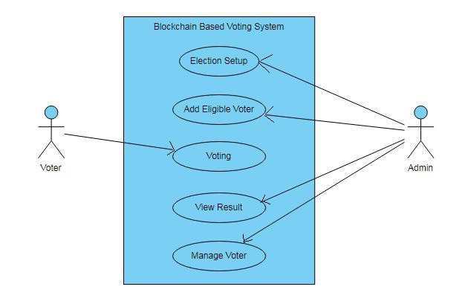
Use Case Diagram

Slide 14
Proposed Work
Existing System:
Ballot system
Electronic Control System
Current Digital Voting System
Proposed Work: As compared to the existing system
The voting is stored in the Blockchain which makes it tamper proof.
As there’s no standing in queue for casting vote it’ll save a lot of time and reduce the workload.

Slide 15
Conclusion
A nation with less voting percentage will fight to develop as choosing a right front-runner for the nation is very essential. Our future system is designed to provide a secure data and dependable voting amongst the people of the equality. Block chain itself has been used in the Bitcoin scheme known as the dispersed bank system. By assuming blockchain in the distribution database on voting system one can reduce the double-dealing sources of database management. This project aims to voting effect using blockchain procedure from every place of election

